Slide 1
Gear Quest
Group members
Syed Faseeh Sajid 25590
Tahir Imtiaz 25594
Hannan Butt 27178

Slide 2
INTRODUCTION
Gear Quest - Revolutionizing Pakistan's Auto Spare Parts Market.
Creating a user-friendly online marketplace for used and new spare parts.
Simplify buying and selling of automotive spare parts in Pakistan.
Aims to bridge gaps in the market for second-hand spare parts.
Offering a seamless, transparent platform for buyers and seller
Background:
Rapidly growing but lacking a dedicated online platform.
Difficulty finding quality used parts at reasonable prices.
Limited market reach for sellers and repair shops.
Address the market gaps by creating a specialized online marketplace.
Provide a convenient solution for buyers and sellers.

Slide 3
PROBLEM STATEMENT
Challenges Faced:
Difficulty in finding high-quality, affordable second-hand spare parts for vehicles.
Lack of a dedicated platform resulting in a fragmented market for buyers and sellers.
Vehicle owners and repair shops facing hurdles in reaching a broader market to sell spare parts.
Absence of a platform providing comprehensive information and trust-building mechanisms for used spare parts.

Slide 4
SOLUTION
The "Gear Quest" Solution:
Create a seamless online marketplace tailored for second-hand spare parts.
Providing a user-friendly interface, detailed product listings, and trust-building mechanisms.
Bridge the gaps, offering transparency and convenience for both buyers and sellers.

Slide 5
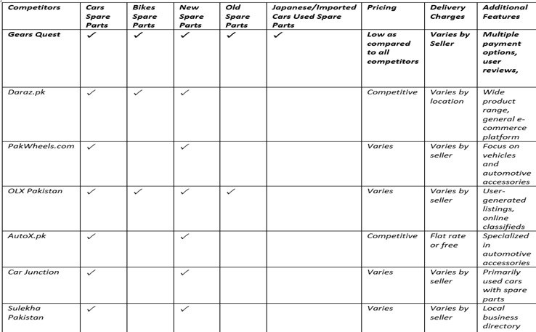
COMPETITVE ANALYSIS

Slide 6
FEATURES AND SCOPE
Features:
Comprehensive Listings
Advanced Search and Filters
Secure Transactions
Review and Rating System
User-Friendly Interface
Scope:
Buyer Panel
Seller Panel
Admin Panel
Transparency and Trust Building
Accessibility and Convenience

Slide 7
FUNCTIONAL REQUIRMENTS
Functional Requirements:
User Management
Product Management
Search and Filtering
Transaction and Order Processing
Review and Rating System

Slide 8
NON-FUNCTIONAL REQUIRMENTS
Non Functional Requirements:
Performance
Security
Usability

Slide 9
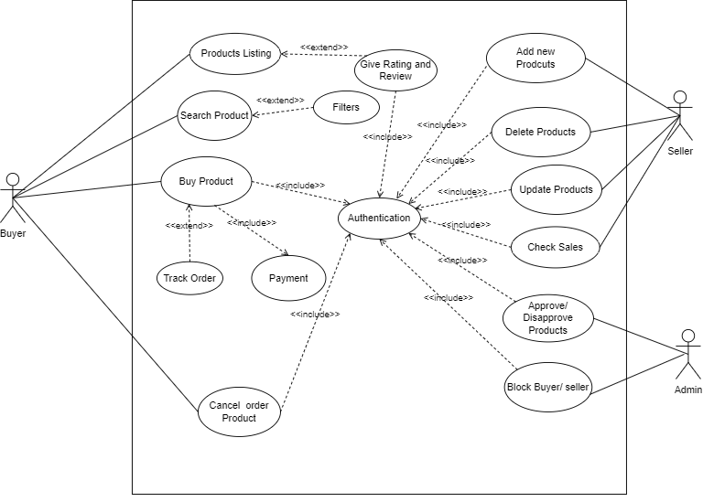
USE CASE

Slide 10
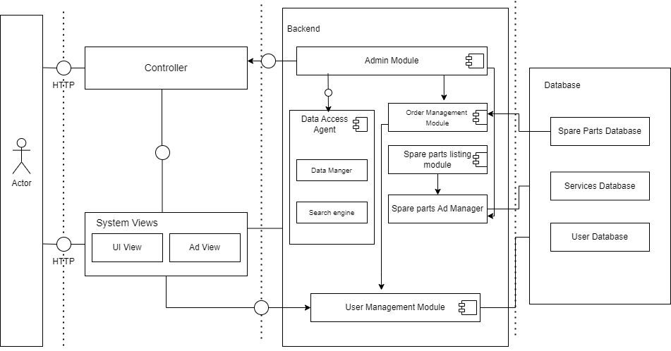
ARCHITECTURE DIAGRAM

Slide 11
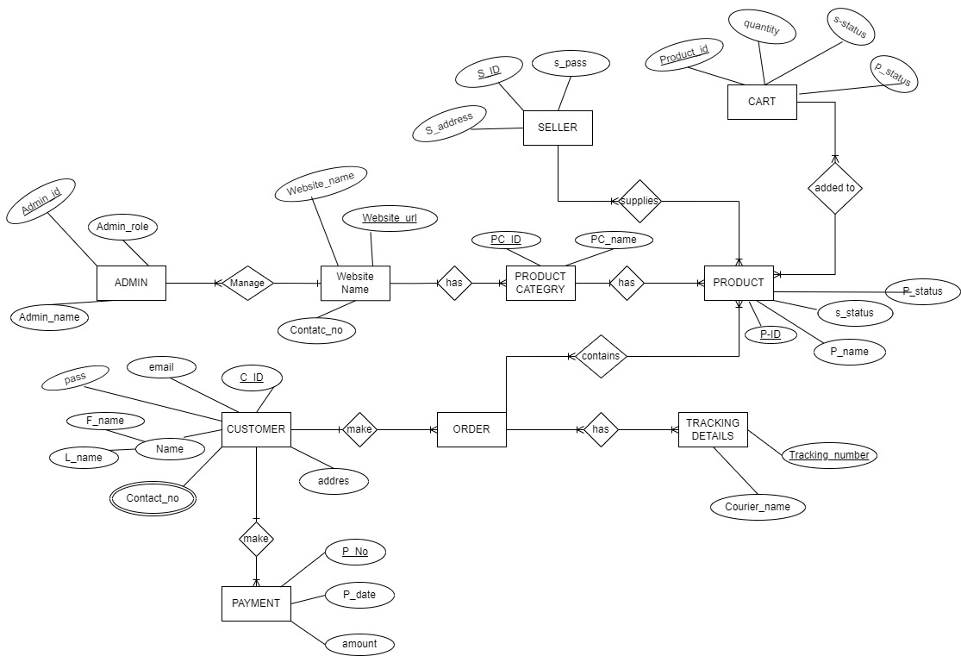
ERD

Slide 12
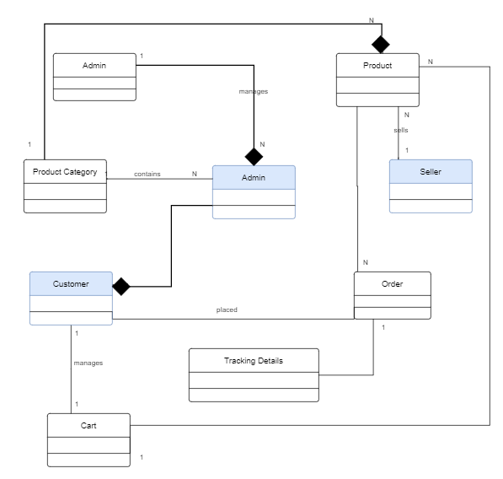
DOMAIN MODEL

Slide 13
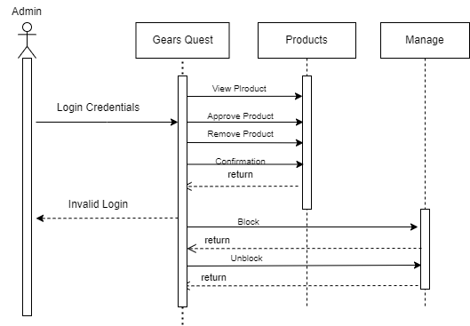
SEQUENCE DIAGRAM
ADMIN

Slide 14
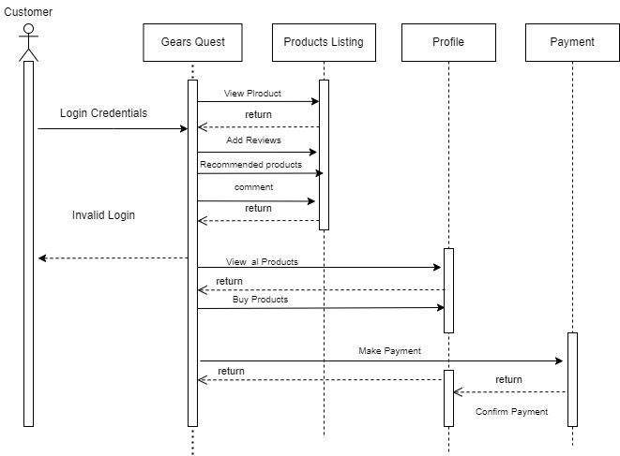
SEQUENCE DIAGRAM
CUSTOMER

Slide 15
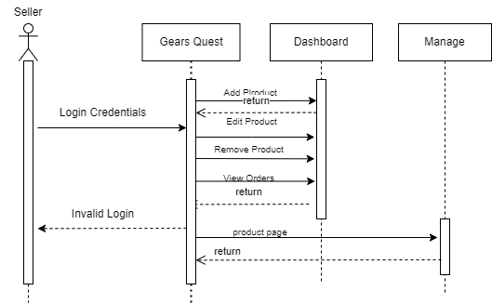
SEQUENCE DIAGRAM
SELLER

Slide 16
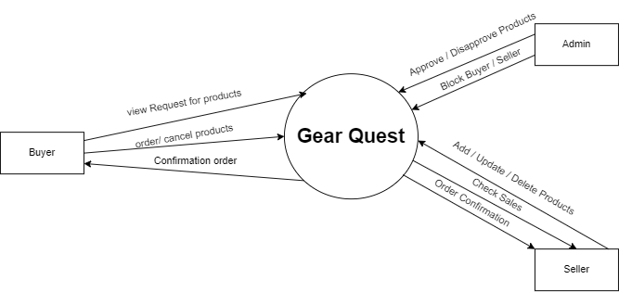
DFD LEVEL 0
.

Slide 17
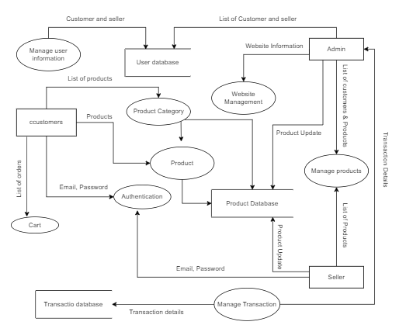
DFD LEVEL 1
.

Slide 18
THANK YOU ☺
.
.

